Slide 1
Chapter 11 Biotechnology Principles¹ and Processes²
1. Principles/Rule/law/Doctrine: scientific theorem/law/concept/Idea
1. Processes: Step by step events aimed to achieve an activity

Slide 2
Biology
= Biosciences
= Life sciences
=> natural sciences
How do you describe biotechnology?

Slide 3
Biotechnology
Biotechnology became a branch of biology in the twentieth century
Biotechnology had been changing our daily life as biotechnological products brought qualitative improvement in health and food production.
Biotechnology deals with
techniques of using live organisms to produce products (specially microbial processes for making curd, bread or wine)
enzymes from organisms to produce products
genetically modified organisms
biotechnological techniques. For example, in vitro fertilisation leading to a ‘test-tube’ baby, synthesising a gene and using it, developing a DNA vaccine or correcting a defective gene, etc.
many other processes useful to humans

Slide 4

Definition of Biotechnology
According to European Federation of Biotechnology (EFB), Biotechnology is defined as;
‘The integration of natural science and organisms, cells, parts thereof, and molecular analogues for products and services’.
This definition encompasses both traditional view and modern molecular biotechnology.

Slide 5
Two core techniques of biotechnology
The two core techniques of biotechnology (that enabled birth of modern biotechnology) are:
Genetic engineering/rDNA Technology: Techniques to alter the chemistry of genetic material (DNA and RNA), to introduce these into host organisms and thus change the phenotype of the host organism.
Maintenance of sterile ambience (microbial contamination-free) in chemical engineering processes to enable growth of only the desired microbe/eukaryotic cell in large quantities for the manufacture of biotechnological products like antibiotics, vaccines, enzymes, etc.

Slide 6


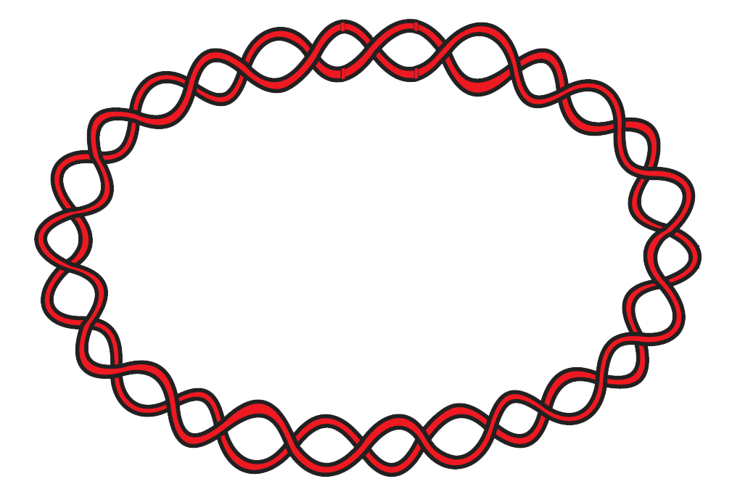
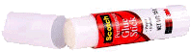
Principles and process of rDNA technology
Restriction endonuclease
Restriction endonuclease
Foreign DNA
Desirable DNA
Vector DNA
(Plasmid)
rDNA
Ligase
(Join foreign/desirable DNA to plasmid)
Transformation
(Introduction of a piece of DNA)
Downstream processing
and
quality control testing
Amplification/Cloning

Slide 7
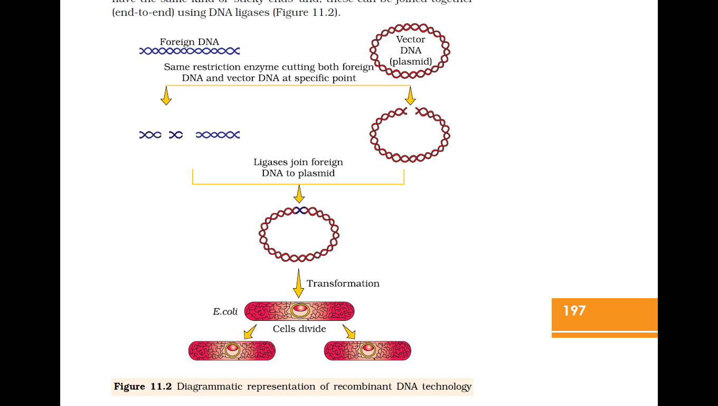
Diagrammatic representation of recombinant DNA technology
rDNA

Slide 8
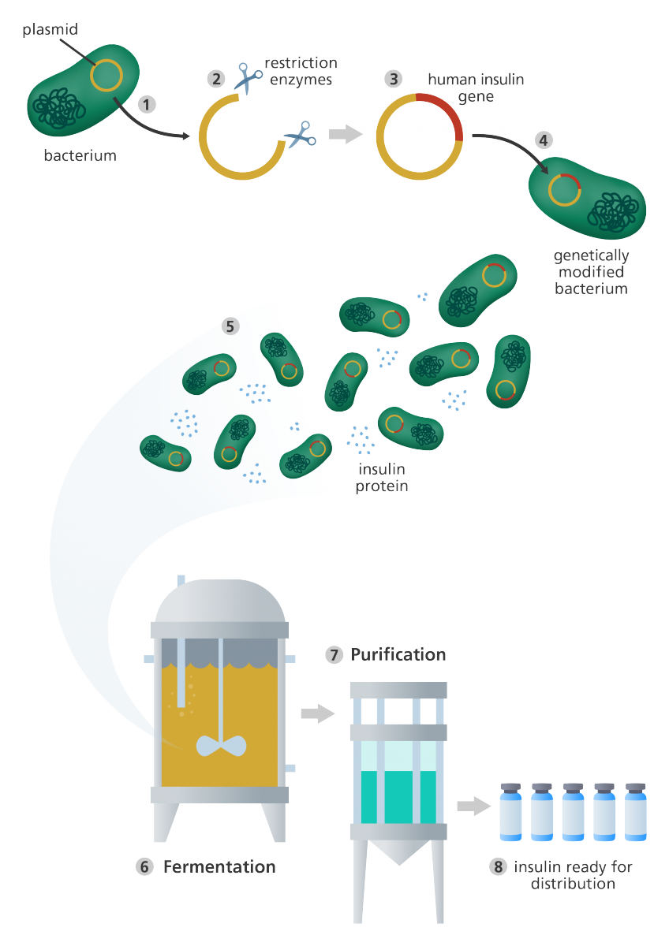

Slide 9
Processes Of Recombinant DNA Technology
Recombinant DNA technology involves several steps in specific sequence such as
Isolation of DNA,
Fragmentation/cutting of DNA by restriction endonucleases at specific locations,
Isolation of a desired DNA fragment and amplification of gene of interest using PCR,
Ligation of the DNA fragment into a vector,
Transferring/insertion the recombinant DNA into the host cell/organism,
Culturing the host cells in a medium at large scale to obtain the foreign gene product and
Downstream processing i.e. extraction of the desired product

Slide 10
Techniques of genetic engineering
The techniques of genetic engineering which include
creation of recombinant DNA,
use of gene cloning and
gene transfer
The techniques of genetic engineering allows us
to isolate one or a set of desirable genes and
introduce only one or a set of desirable genes without introducing undesirable genes into the target organism.
rDNA
Transformation
(Introduction of a piece of DNA)

Slide 11
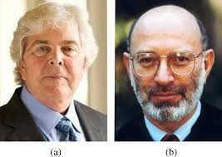
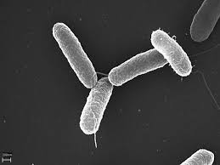
First Recombinant DNA (rDNA) was constructed by Stanley Cohen and Herbert Boyer in 1972
How did they constructed the first rDNA?
Identified and isolated the gene encoding antibiotic resistance in the native plasmid of Salmonella typhimurium
Desired DNA was cut by restriction enzymes
Cut DNA was linked to plasmid DNA
Transferred to E. coli for gene multiplication.
Herbert Boyer
Stanley Cohen
Electron micrograph of Salmonella typhimurium

Slide 12
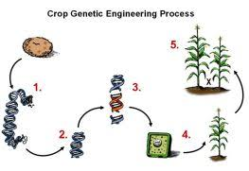
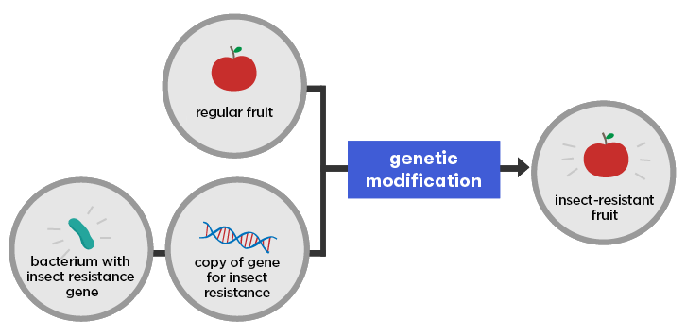
The three basic steps in genetically modifying an organism
Identification of DNA with desirable genes
Introduction of the identified DNA into the host
Maintenance of introduced DNA in the host and transfer of the DNA to its progeny.

Slide 13
What is the fate of a piece of foreign DNA which is transferred into an alien organism?
The piece of DNA would not be able to multiply itself in the progeny cells of the organism.
Piece of DNA (Gene of interest/foreign DNA/Alien DNA)
Piece of DNA gets integrated into the genome of the recipient/ host organism at ori
Cloning (making multiple identical copies of any template DNA)
Piece of DNA inherited along with the host DNA.

Slide 14
Tools of rDNA Technology
Enzymes
Nucleases/Restriction enzymes (cut DNA at recognition site)
Ligases
Polymerase enzymes
Vectors like Plasmids, bacteriophages and cosmids (transfer the piece of DNA attached to it)
Host organism/cell (E. coli)

Slide 15
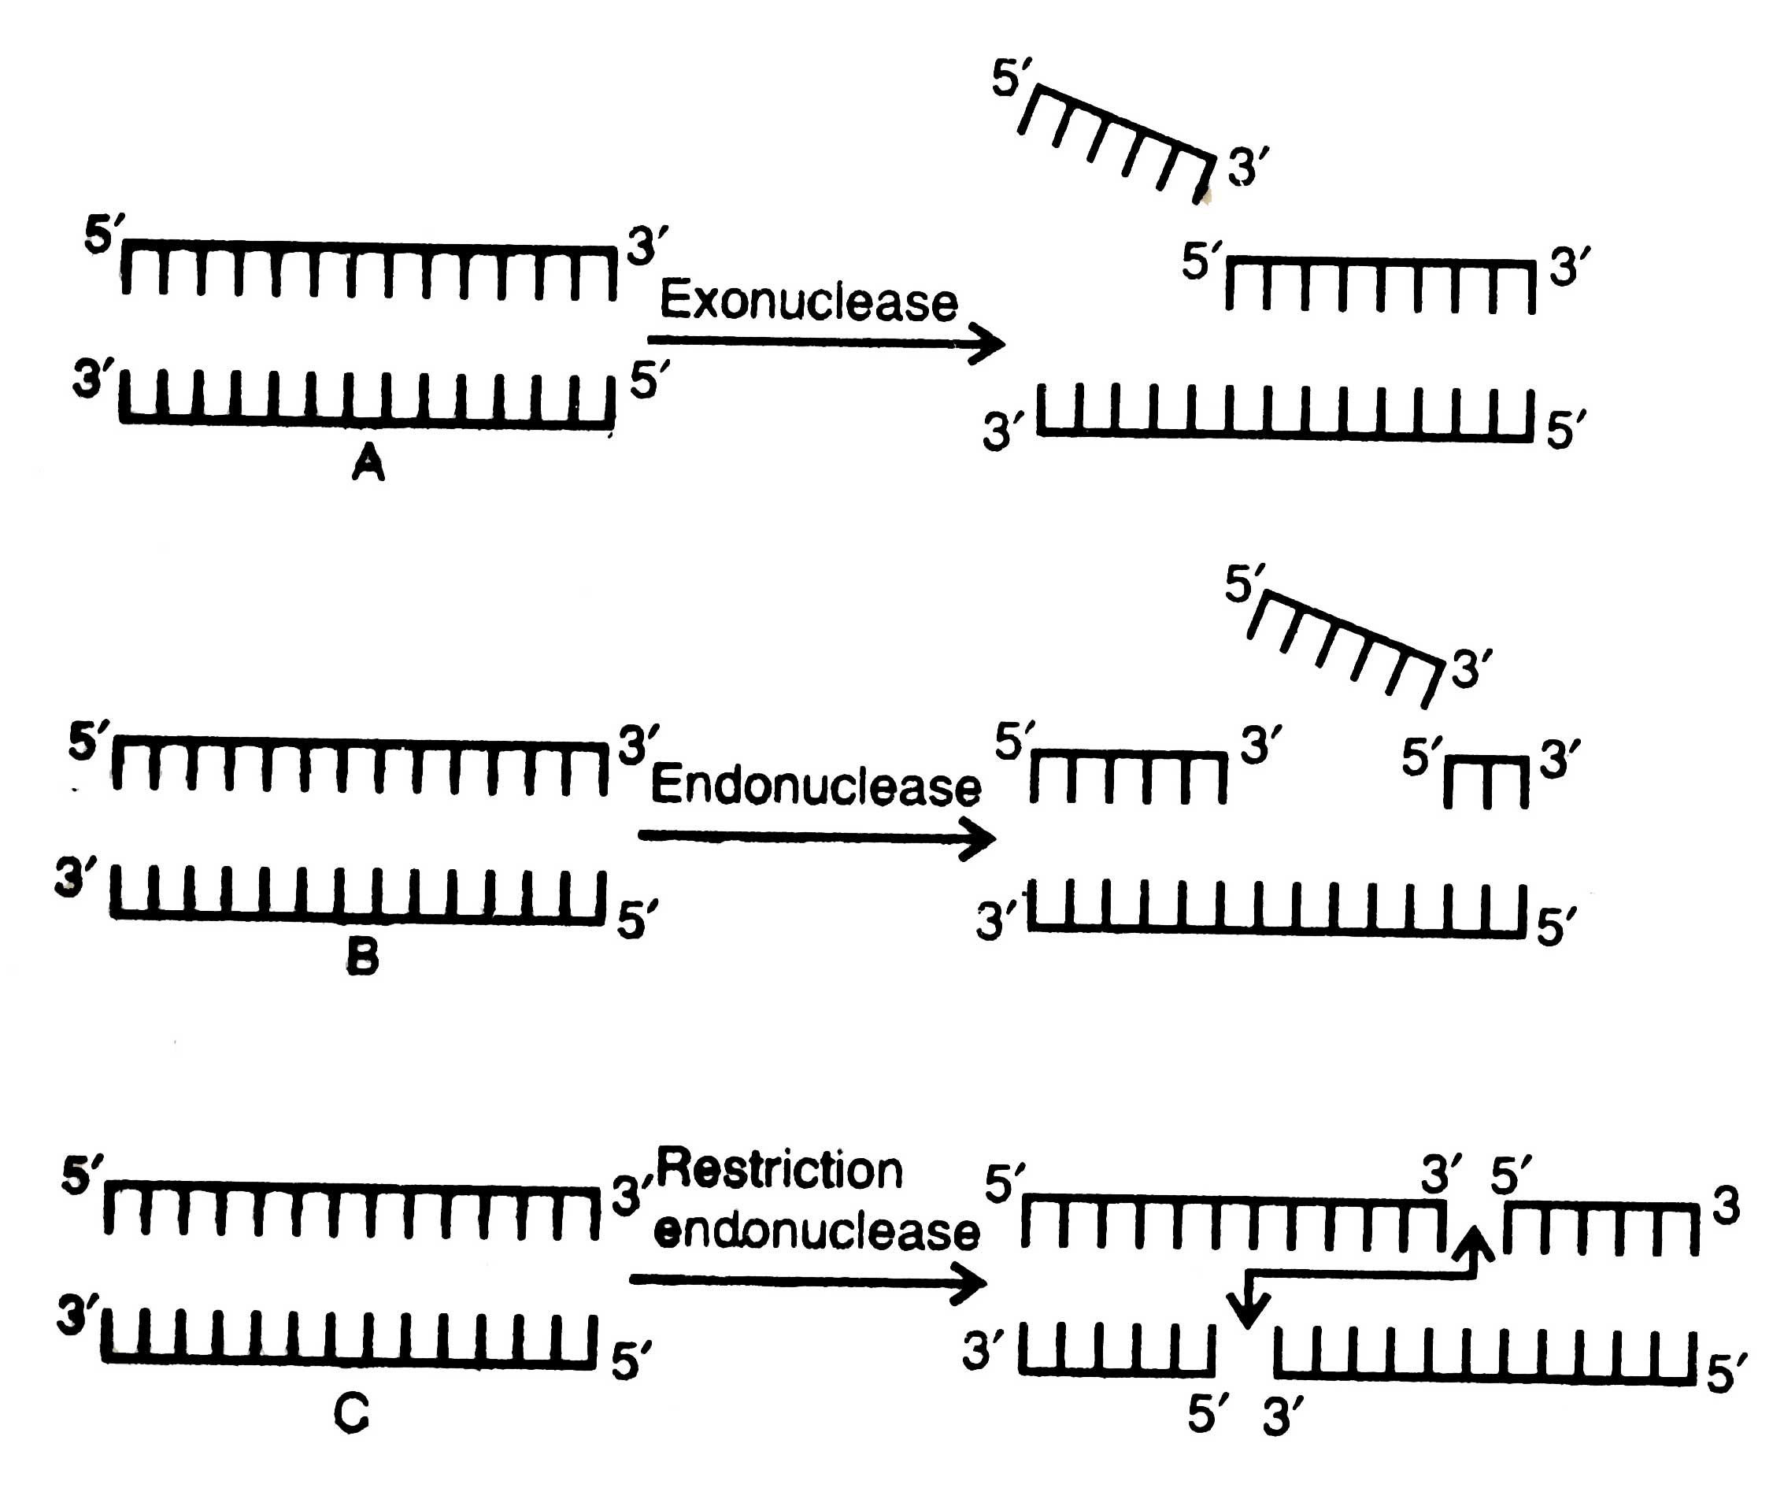
Restriction Enzyme (Molecular scissors)
Naturally, present in bacteria to provide a type of defense mechanism against bacteriophage.
Responsible for cutting DNA at recognition sequence (i.e sequence of base pair recognised by restriction enzyme)
Generate sticky ends
Nucleases is the collective term used for restriction enzymes.
Types of restriction nucleases
Exonucleases | Endonucleases
Remove nucleotides from the ends of the DNA
Make cuts at specific positions within the DNA

Slide 16
Activity of Restriction Enzyme
Restriction endonuclease inspect the length of a DNA sequence and finds its specific recognition sequence.
Finally, it will bind to the DNA and cut each of the two strands of the double helix at specific points in their sugar-phosphate backbones.
Restriction endonuclease recognises a specific palindromic nucleotide sequences in the DNA i.e. sequences of DNA reads the same on the two strands either in 5‘  3' direction or in the 3‘ 5' direction.
5' —— GAATTC —— 3'
3' —— CTTAAG —— 5'
EcoRI
5' —— GAATTC—— 3'
3' —— CTTAAG—— 5'
EcoRI
5' —— GAATTC—— 3’
3’-G—— 5'
5' —— G-3'
3' —— CTTAAG—— 5'
Palindrome: groups of letters that form the same words when read both forward and backward E.g., MOM, MALAYALAM, etc

Slide 17
Restriction endonuclease (EcoRI) cuts both the DNA between G and A only when palindromic recognition sequence GAATCC is present in DNA
EcoRI
EcoRI
G
A
A
T
G
G
A
A
T
T
C
T
C
G
A
A
T
T
C
C
T
T
A
C
T
T
A
A
G
G
A
G
C
T
T
A
A
G
Vector DNA
Foreign DNA
Recombinant DNA (rDNA)
EcoRI
EcoRI

Slide 18
Restriction endonuclease (EcoRI) cuts both the DNA between G and A only when palindromic recognition sequence GAATCC is present in DNA
EcoRI
EcoRI
G
A
A
T
T
C
G
A
A
T
T
C
C
T
T
A
A
G
C
T
T
A
A
G
Vector DNA
Foreign DNA
EcoRI
EcoRI
G
G
A
A
T
T
C
C
T
T
A
A
G
G
G
G
A
A
T
T
C
C
T
T
A
A
G
G
Recombinant DNA
(rDNA)

Slide 19
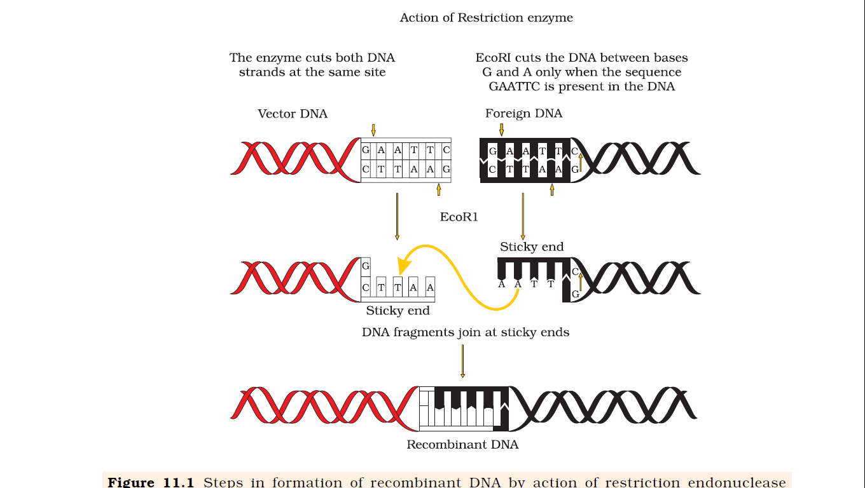
Action of restriction endonuclease (EcoRI) and formation of recombinant DNA
EcoRI has palindromic recognition sequence

Slide 20
Naming Restriction Enzyme
Eco RI is isolated from Escherichia coli RY13
EcoRI
Roman number I: order in which the enzymes were isolated from that strain of bacteria.
Genus
First two name of species
Strain

Slide 21
Separation and isolation (purification) of DNA fragments
by agarose gel electrophoresis

Slide 22
Figure: A typical agarose gel electrophoresis equipment
Voltage source (Power supply)
Electrodes
Casting tray
Wells (loaded with DNA)
Agarose gel
Cathode(-Terminal)
Gel tank
Anode (+ Terminal)

Slide 23
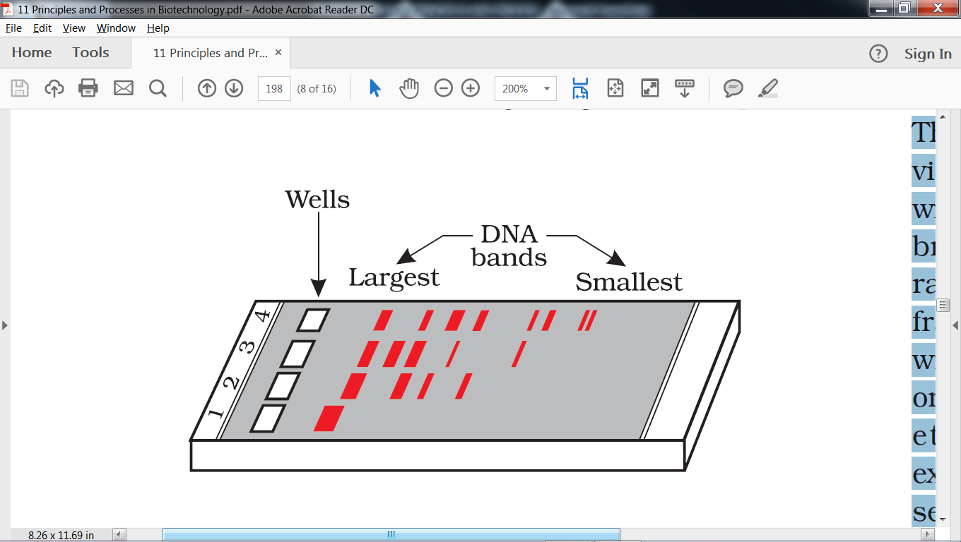
Figure: A typical agarose gel electrophoresis showing migration of undigested (lane 1) and digested set of DNA fragments (lane 2 to 4)
Cathode(-Terminal)
Anode(+Terminal)

Slide 24
Separation and isolation of DNA fragments by agarose gel electrophoresis
The most commonly used matrix is agarose -a natural polymer extracted from sea weeds (algae) like produced from Gelidium and Gracilaria.
Uses restriction endonucleases for cutting/fragmentation of DNA
Agarose gel electrophoresis is used to separate fragments of DNA on the basis of size, molecular weight and charge.
Negatively charged DNA fragments are separated (resolved) by forcing them to move towards the anode under an electric field through a medium/matrix.

Slide 25
Figure: A typical agarose gel electrophoresis equipment for Separation and isolation (purification) of DNA fragments
Voltage source (Power supply)
Electrodes
Casting tray
Wells (loaded with DNA)
Agarose gel
Cathode(-Terminal)
Gel tank
Anode (+ Terminal)

Slide 26
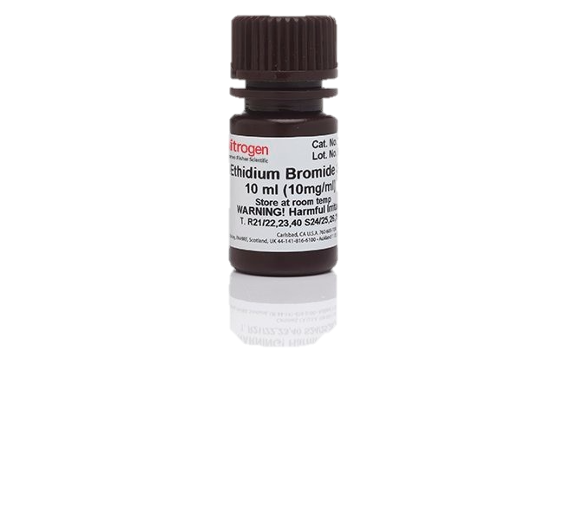
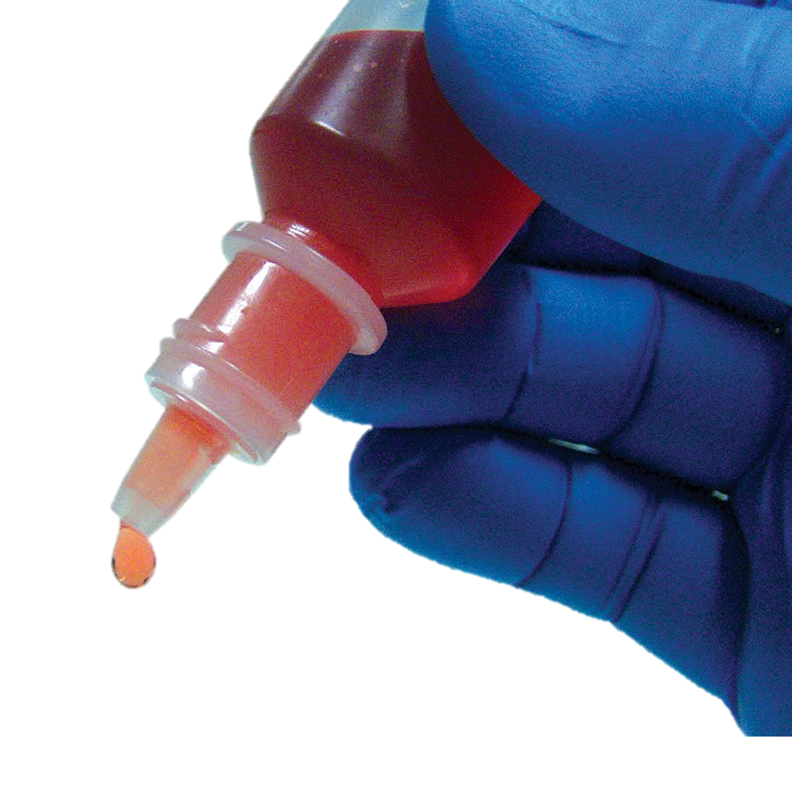
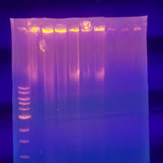
Visualisation of isolated fragments of DNA
The separated DNA fragments in the agarose gel are stained with ethidium bromide (dye/stain) and visualised by exposure to UV radiation
DNA fragments appear bright orange coloured bands of ethidium bromide when exposed to UV light.
The separated bands of DNA are cut out from the agarose gel and extracted from the gel piece. This step is known as elution.
The purified DNA fragments are used in constructing recombinant DNA by joining them with cloning vectors.
Bright orange coloured bands
(DNA + Ethidium bromide)
rDNA

Slide 27

What is transformation with reference to genetic engineering?
Transformation is a procedure through which a piece of DNA is introduced in a host bacterium.
Transformation
Transformants/Recombinants
Non transformants/Non-recombinant

Slide 28

Explain transduction
Transduction is transfer of genetic material from one bacterium to another through the mediation of a viral vector.

Slide 29
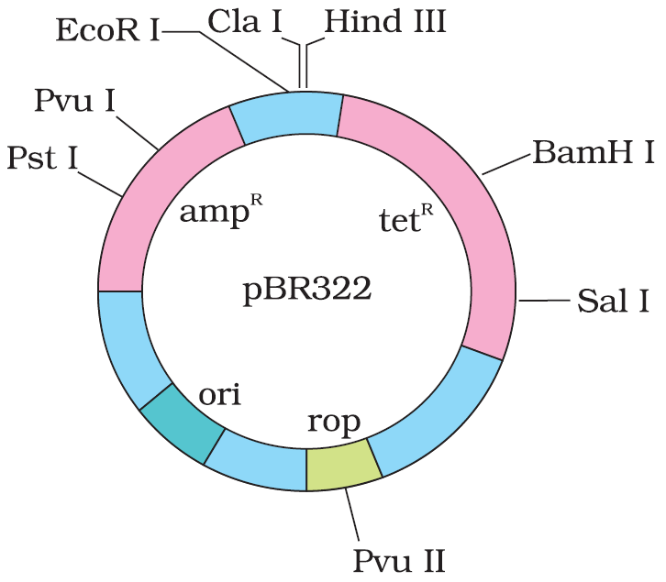
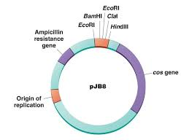

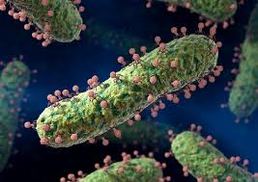
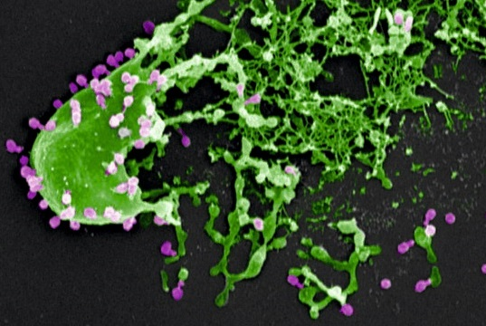
Cloning Vectors
Cloning vectors used in rDNA Technology: Plasmids, bacteriophages and cosmids (hybrids between plasmid and λ phage vectors)
Plasmids and bacteriophages have the ability to replicate within bacterial cells independent of the control of chromosomal DNA.
Bacteriophages because of their high number per cell, have very high copy numbers* of their genome within the bacterial cells (= one or two copies of plasmids per cell whereas others may have 15-100 copies per cell or more).
High copy numbers of cloning vector (DNA) per cell enable scientists to multiply its numbers equal to the copy number of the plasmid or bacteriophage.
Vectors are genetically engineered for easy linking of foreign DNA and selection of recombinants from non-recombinants.
Plasmid vector
Cosmid vector
Bacteriophages
High number bacteriophages per bacteriall cell
rDNA
*number of copies of vector present in a cell

Slide 30
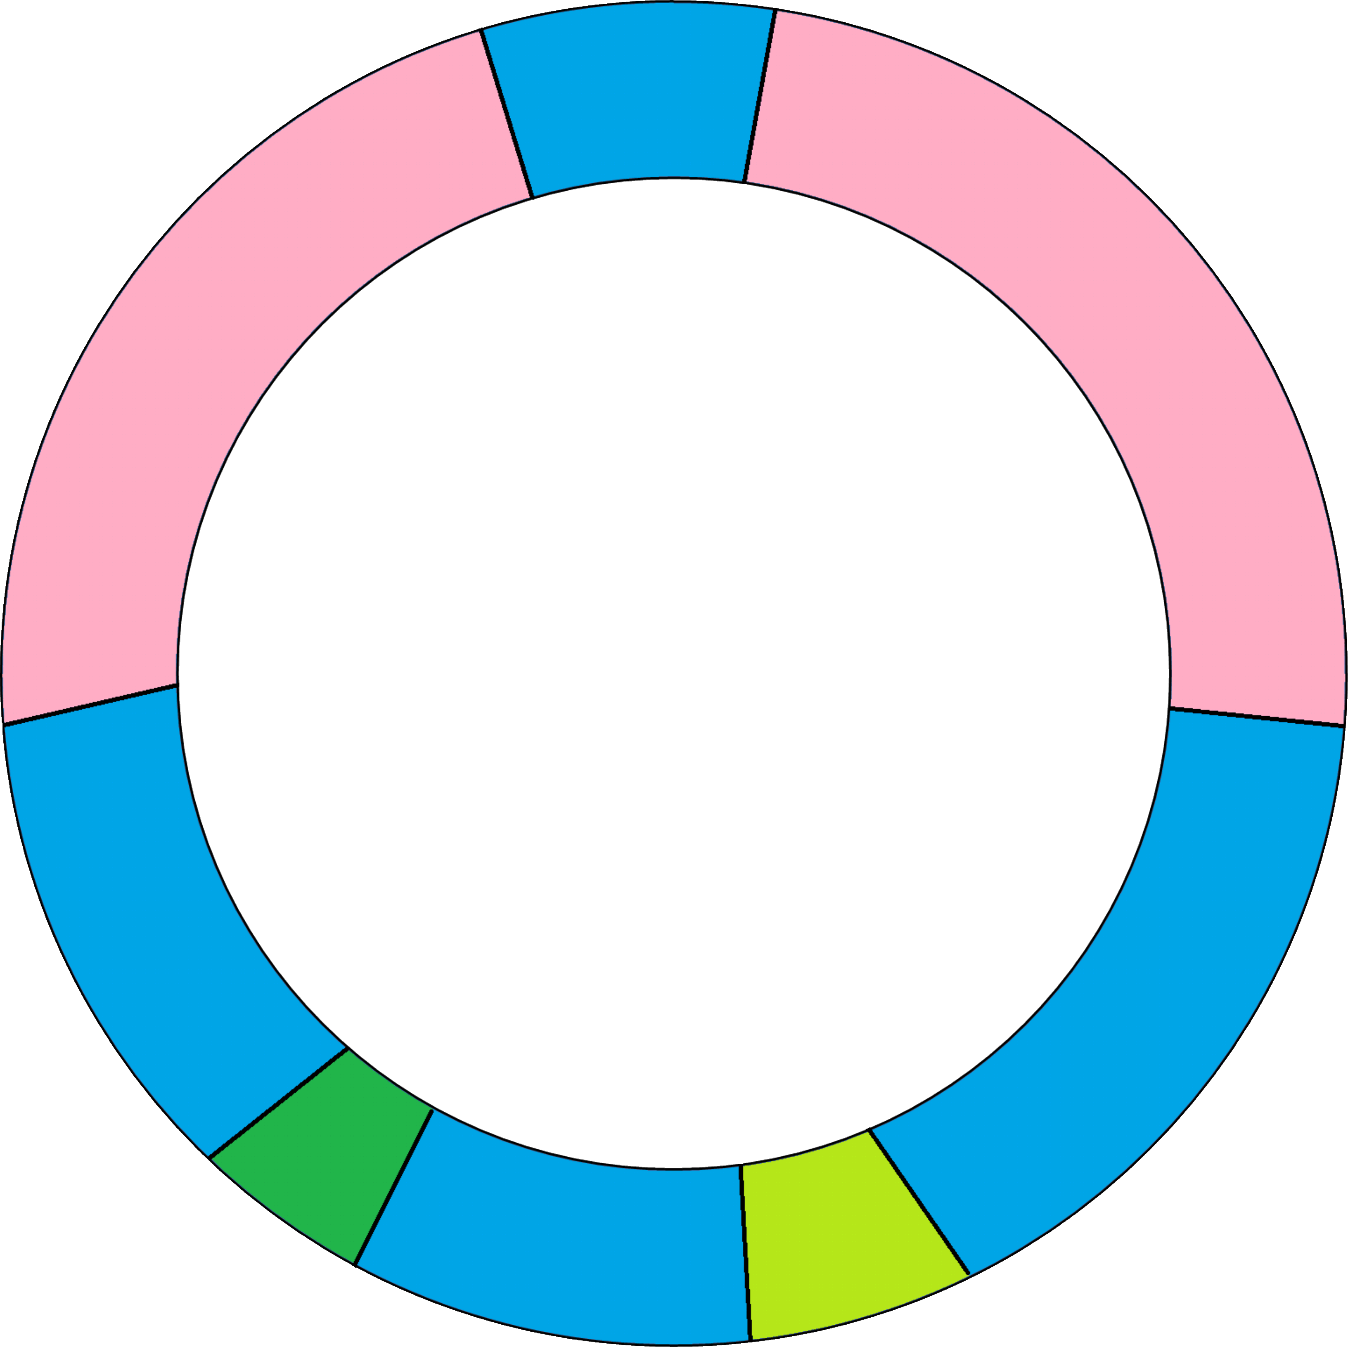
pBR322 is the widely used E. coli cloning vectors in rDNA Technology
p stands for "plasmid," and BR for ”Francisco Bolivar Zapata" and "Raymond L Rodriguez.
Features of pBR322
Origin of replication (ori)
Selectable marker: are genes encoding resistance to antibiotics (tetracycline; tet^{R} or ampicillin amp^{R})
Cloning/restriction sites (Pst I, Pvu I, EcoR I, Cla I, Hind III, Hind III, Sal I, Pvu II)
rop (Codes for proteins involved in replication of plasmid)
Cla I
Hind III
EcoRI
PvuI
BamH I
Pst I
amp^{R}
tet^{R}
Sal I
pBR322
ori
rop
Pvu II

Slide 31
Features that are required by a good cloning vector
Good cloning vectors should have
Origin of replication (ori)
Selectable marker
Cloning sites
Should be able to clone genes in host organism.
Why is the pBR322 a good genetically engineered cloning vector?
Answer: pBR322 a good genetically engineered cloning vector because it possesses the features that are required by a good cloning vector as stated below;
pBR322 have
Origin of replication (ori)
Selectable marker
Cloning sites
pBR322 Vectors can be used to clone genes in host organism.

Slide 32
Origin of replication (ori)
Ori is a sequence from where replication starts
Gene of interest/desired gene/alien gene/target DNA (piece of DNA) can be linked to ori site to clone it within the host cells.
Ori is also responsible for controlling the copy number of the linked DNA.
To get many copies of the target DNA it should be cloned in a vector whose origin support high copy number.

Slide 33
Cloning sites/recognition sites/restriction site
For linking alien DNA, the vector needs to have very few, preferably single, recognition sites for the commonly used restriction enzymes.
Presence of more than one recognition sites within the vector will generate several fragments, which will complicate the gene cloning.
Alien DNA can be ligated at a restriction site present in one of the two antibiotic resistance genes in pBR322.
For example, foreign DNA can be ligated at the Bam HI site of tetracycline resistance gene in the vector pBR322.
Insertion/ligation of a foreign DNA at the Bam HI site of tetracycline resistance gene in the vector pBR322 create a recombinant plasmids with lost tetracycline resistance

Slide 34
Selectable marker
The cloning vector should have selectable marker
Useful selectable markers for E. coli are the genes encoding resistance to antibiotics such as ampicillin, chloramphenicol, tetracycline or kanamycin, etc.,
The normal E. coli cells do not carry resistance against any of these antibiotics.
Uses of selectable marker
helps in identifying and eliminating non transformants and
selectively permit the growth of the transformants.

Slide 35
Methods of selection of recombinants
Selection of recombinants formed can be done by;
Inactivation of antibiotic resistant gene
Insertional inactivation

Slide 36
Inactivation of gene encoding antibiotics by insertion of alien DNA
One antibiotic resistance gene of pBR322 helps in selecting the transformants
The other antibiotic resistance gene gets ‘inactivated due to insertion’ of alien DNA, and helps in selection of recombinants.
Selection of recombinants due to inactivation of antibiotics is a cumbersome procedure because it requires simultaneous plating on two plates having different antibiotics.
BamH I
amp^{R}
tet^{R}
Non transformants/Non-recombinant
Plating
Transformants/Recombinants

Slide 37
What is transformation with reference to genetic engineering?
Transformation is a procedure through which a piece of DNA is introduced in a host bacterium.
Transformation
Transformants/Recombinants
Non transformants/Non-recombinant

Slide 38
How does selection of recombinants is achieved?
Recombinant
Plating
Ampicillin containing medium
Plating
Tetracycline containing medium
The recombinants will grow in ampicillin containing medium but not on that containing tetracycline.
Notes:
Selection of recombinant pBR322 from non-recombinant ones is done by plating the transformants on ampicillin containing medium.
The transformants growing on ampicillin containing medium are then transferred on a medium containing tetracycline.
The recombinants will grow in ampicillin containing medium but not on that containing tetracycline.
Non recombinants will grow on the medium containing both the antibiotics.

Slide 39
How does selection and elimination of non-recombinants is achieved?
Plating
Ampicillin containing medium
Non-recombinant
Plating
Tetracycline containing medium
Non recombinants will grow on the medium containing both the antibiotics.
Notes:
Selection of recombinant pBR322 from non-recombinant ones is done by plating the transformants on ampicillin containing medium.
The transformants growing on ampicillin containing medium are then transferred on a medium containing tetracycline.
The recombinants will grow in ampicillin containing medium but not on that containing tetracycline.
Non recombinants will grow on the medium containing both the antibiotics.

Slide 40
How does selection of recombinants is achieved?
Recombinant
Plating
Ampicillin containing medium
Non-recombinant
Plating
Tetracycline containing medium
The recombinants will grow in ampicillin containing medium but not on that containing tetracycline.
Non recombinants will grow on the medium containing both the antibiotics.
Notes:
Selection of recombinant pBR322 from non-recombinant ones is done by plating the transformants on ampicillin containing medium.
The transformants growing on ampicillin containing medium are then transferred on a medium containing tetracycline.
The recombinants will grow in ampicillin containing medium but not on that containing tetracycline.
Non recombinants will grow on the medium containing both the antibiotics.

Slide 41
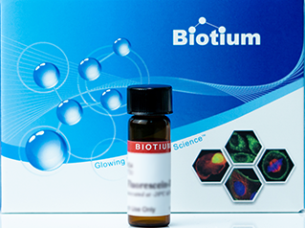
Insertional inactivation
Insertional inactivation
No Insertion of gene of interest
Gene for β-galactosidase
Vector
Gene of interest
rDNA
Produce β-galactosidase
Plating
No expression of β-galactosidase
Plating
Blue coloured colonies
Colonies do not produce any colour
Chromogenic substrate*
containing medium
Chromogenic substrate*
containing medium
*Green-β-D-Gal (N-Methylindolyl-β-D-galactopyranoside)
Notes:
Selection of recombinant pBR322 from non-recombinant ones is done by plating the transformants on ampicillin containing medium.
The transformants growing on ampicillin containing medium are then transferred on a medium containing tetracycline.
The recombinants will grow in ampicillin containing medium but not on that containing tetracycline.
Non recombinants will grow on the medium containing both the antibiotics.

Slide 42
Insertional inactivation
Another selectable marker differentiate recombinants from non-recombinants on the basis of their ability to produce colour in the presence of a chromogenic substrate.
In Insertional inactivation, a recombinant DNA is inserted within the coding sequence of an enzyme, β-galactosidase. This results into inactivation of the enzyme, which is referred to as insertional inactivation.
The presence of a chromogenic substrate gives blue coloured colonies if the plasmid in the bacteria does not have an insert.
Presence of insert results into insertional inactivation of the β-galactosidase and the colonies do not produce any colour, these are identified as recombinant colonies.

Slide 43
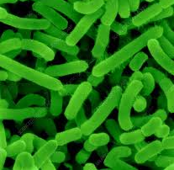

Vectors for cloning genes in plants and animals
Vectors used to transfer genes in plants and animals:
Bacteria (Modified Agrobacterium tumifaciens) and
Viruses (Disarmed Retroviruses)
Agrobacterioum tumifaciens is a pathogen of several dicot plants.
Agrobacterioum tumifaciens is able to deliver its ‘T-DNA’ with a piece of desired DNA to transform normal plant cells/tissues.
The transformed clone of cells are used for generating new plants carrying the desired foreign gene (expressing desired trait).
Retroviruses in animals have the ability to transform normal cells into cancerous cells.
Agrobacterium tumifaciens
Disarmed Retroviruses

Slide 44
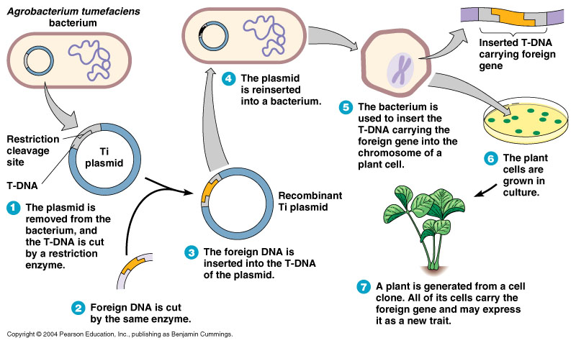
Agrobacterioum tumifaciens as vectors for cloning genes in plants (is able to deliver its ‘T-DNA’ with a piece of desired DNA to transform normal plant cells/tissues)

Slide 45
Processes Of/Facilitating Recombinant DNA Technology
Recombinant DNA technology involves several steps in specific sequence such as
Isolation of DNA,
Fragmentation/cutting of DNA by restriction endonucleases at specific locations,
Isolation of a desired DNA fragment and amplification of gene of interest using PCR,
Ligation of the DNA fragment into a vector,
Transferring/insertion the recombinant DNA into the host cell/organism,
Culturing the host cells in a medium at large scale to obtain the foreign gene product and
Downstream processing i.e. extraction of the desired product

Slide 46
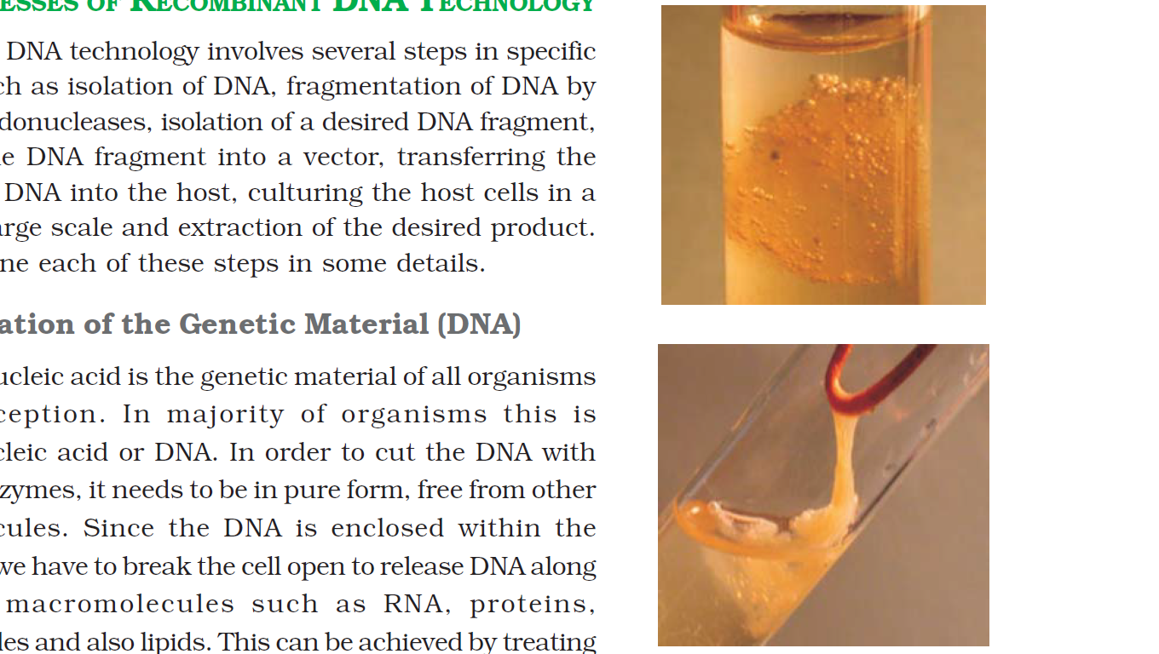
Isolation of the Genetic Material (DNA)
Pure DNA (free from other macro-molecules such as RNA, proteins, polysaccharides and lipids) can be isolated by breaking the cell with different enzymes lysozyme (bacteria), cellulase (plant cells), chitinase (fungus), lipase, etc.
The RNA can be removed by treatment with ribonuclease
Proteins can be removed by treatment with protease.
Purified DNA ultimately precipitates out after the addition of chilled ethanol.
Pure DNA can be seen as collection of fine threads in the suspension.
DNA that separates out can be removed by spooling
Collection of fine threads

Slide 47
Cutting of DNA at Specific Locations
Restriction enzyme digestions are performed by incubating purified DNA molecules (foreign DNA & vector DNA) with the restriction enzyme, at the optimal conditions for that specific enzyme.
Agarose gel electrophoresis is employed to check the progression of a restriction enzyme digestion.
DNA is a negatively charged molecule, hence it moves towards the positive electrode (anode).
DNA fragments separate on the basis of size, molecular weight and charge and identified.
The cut out gene of interest from the source foreign DNA and the cut vector are mixed and ligase is added for creation of rDNA.

Slide 48
Try to answer the following questions after reading the section on PCR from NCERT Textbook
Extend acronym PCR
Answer: PCR stands for Polymerase Chain Reaction
Mention the enzymes used in PCR
Answer: DNA polymerase (taq polymerase), ligase,
What is primers?
Answer: Primers are small chemically synthesised oligonucleotides that are complementary to the regions of DNA
What is the objectives of PCR?
Answer: PCR is used to amplify DNA (gene of interest, vectors, etc) to approximately billion times, i.e., 1 billion copies.
Why taq polymerase is used in PCR?
Answer: Because Thermus aquaticus polymersase (taq polymerase) is a thermostable DNA polymerase which remain active at high temperature.
Who developed PCR?
Answer: PCR was developed by Kary Mullis in the 1980s.
*Must visit video link: https://learn.genetics.utah.edu/content/labs/pcr/

Slide 49
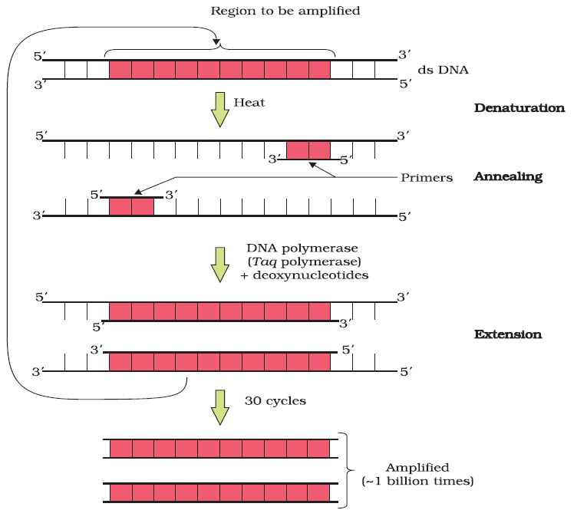
Amplification of Gene of Interest using Polymerase Chain Reaction (PCR)

Slide 50
Amplification of Gene of Interest using Polymerase Chain Reaction (PCR)
Isolation of DNA
Living Cell
1. Denaturation by heating
Added Primer, deoxynucleotides, taq polymerase,
3'
5'
2. Anneal primer
5'
3'
Thermocycler
3'
5'
3. Extension of new strand by taq polymerase by using deoxynucleotides
5'
3'
1. Denaturaton
3'
5'
2. Anneal primer
5'
3'
After 30 cycles
3'
5'
3. Extension of new strand by taq polymerase by using deoxynucleotides
Produce 1 Billion copies of DNA (approx)
5'
3'

Slide 51
Amplification of Gene of Interest using PCR
PCR stands for Polymerase Chain Reaction.
It is also known as molecular photocopying
In PCR, multiple copies of the gene (or DNA) of interest is synthesised in vitro using two sets of primers (small chemically synthesised oligonucleotides that are complementary to the regions of DNA) and the enzyme DNA polymerase.
The enzyme extends the primers using the nucleotides provided in the reaction and the genomic DNA as template.
If the process of replication of DNA is repeated many times, the segment of DNA can be amplified to approximately billion times, i.e., 1 billion copies.
Such repeated amplification is achieved by the use of a thermostable DNA polymerase (isolated from a bacterium, Thermus aquaticus), which remain active during the high temperature induced denaturation of double stranded DNA.
The amplified fragment if desired can now be used to ligate with a vector for further cloning

Slide 52
Application of PCR
used in as molecular diagnostic technique
to detect pathogens like viruses, bacteria
to detect mutations in genes in suspected cancer patients.
to identify many other genetic disorders.
used in forensic investigations (DNA finger printing),
Used in research labs of agricultural biotechnology and molecular biology labs.

Slide 53
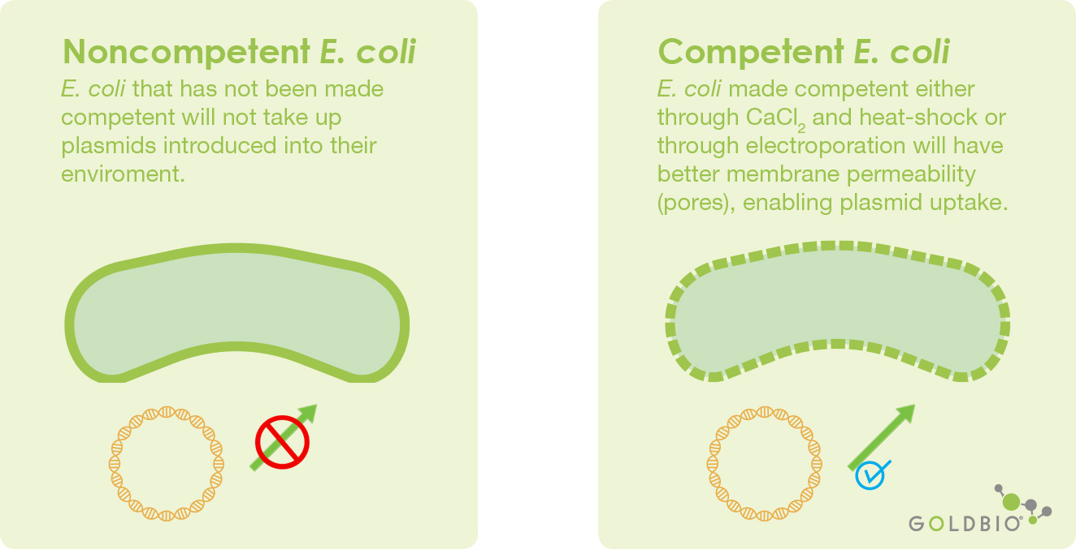
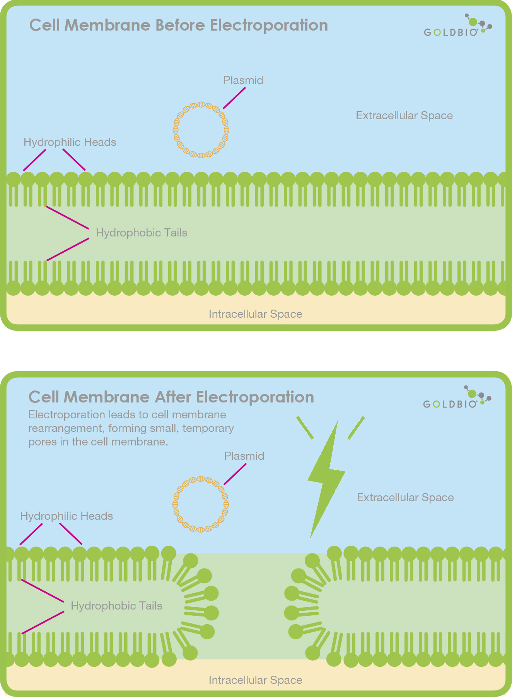
Competent Host (for Transformation with rDNA)
DNA is a hydrophilic molecule (negatively charged), it cannot pass through cell membranes.
Some methods used to introduce alien DNA into host cells
Making bacterial cells competent to take up DNA.
micro-injection
biolistics or gene gun
Use of disarmed pathogen vectors
Notes:
This is done by treating them with a specific concentration of a divalent cation, such as calcium, which increases the efficiency with which DNA enters the bacterium through pores in its cell wall. Recombinant DNA can then be forced into such cells by incubating the cells with recombinant DNA on ice, followed by placing them briefly at 420C (heat shock), and then putting them back on ice. This enables the bacteria to take up the recombinant DNA. This is not the only way to introduce alien DNA into host cells. In a method known as micro-injection, recombinant DNA is directly injected into the nucleus of an animal cell.

Slide 54
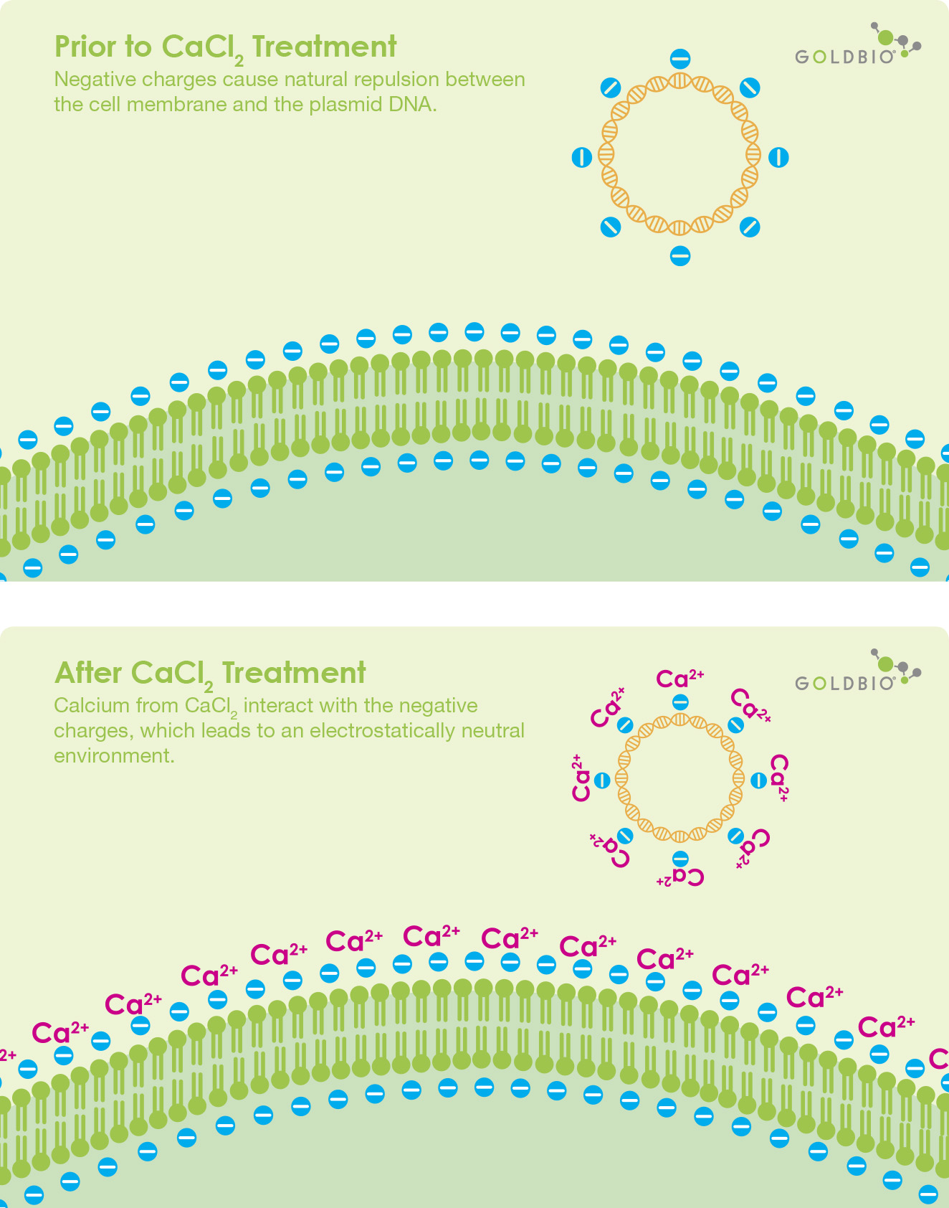
How do bacterial cells are made competent to take up DNA?
Treatment of bacterial cells with a specific concentration of a divalent cation, such as calcium
Calcium increases the efficiency with which DNA enters the bacterium through pores in its cell wall
Incubation of the cells with recombinant DNA on ice
Bacterial cells take up recombinant DNA
Placing recombinants briefly at 42 ºC (heat shock)
Enables the bacteria to take up the recombinant DNA
Put recombinants back on ice
Notes:
This is done by treating them with a specific concentration of a divalent cation, such as calcium, which increases the efficiency with which DNA enters the bacterium through pores in its cell wall.
Recombinant DNA can then be forced into such cells by incubating the cells with recombinant DNA on ice, followed by placing them briefly at 420C (heat shock), and then putting them back on ice. This enables the bacteria to take up the recombinant DNA. This is not the only way to introduce alien DNA into host cells. In a method known as micro-injection, recombinant DNA is directly injected into the nucleus of an animal cell.

Slide 55
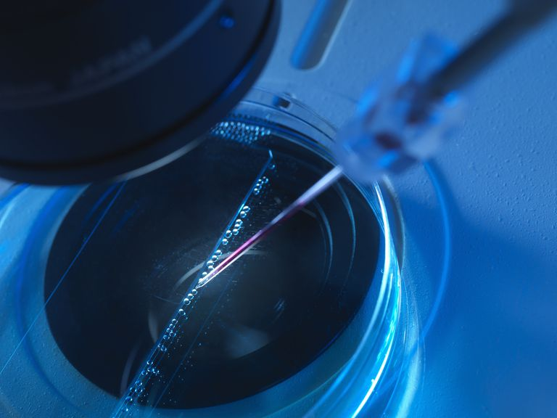
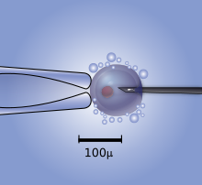
Micro-injection method for transformation with recombinant DNA
Using micro-injection method, recombinant DNA is directly injected into the nucleus of an animal cell.
Micro-injection
(with foreign DNA)
Holding micropipette
Host cell
Notes:
This is done by treating them with a specific concentration of a divalent cation, such as calcium, which increases the efficiency with which DNA enters the bacterium through pores in its cell wall. Recombinant DNA can then be forced into such cells by incubating the cells with recombinant DNA on ice, followed by placing them briefly at 420C (heat shock), and then putting them back on ice. This enables the bacteria to take up the recombinant DNA. This is not the only way to introduce alien DNA into host cells. In a method known as micro-injection, recombinant DNA is directly injected into the nucleus of an animal cell.

Slide 56
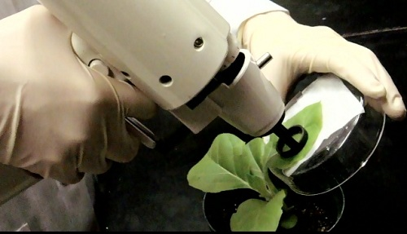
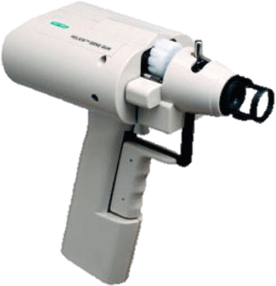
Biolistics or gene gun method for transformation with recombinant DNA
Biolistics or gene gun method is suitable for plants cells
Plants cells are bombarded with high velocity micro-particles of gold or tungsten coated with DNA
DNA coated gold/tungsten particles
Gene gun
Target plant cells

Slide 57
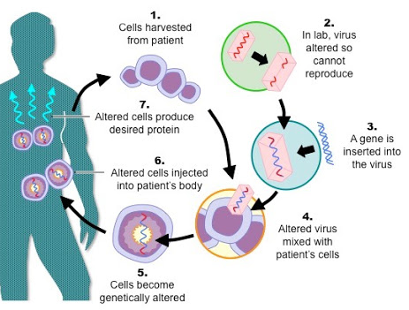
Disarmed pathogen’ vectors for transformation with recombinant DNA
In this method, disarmed pathogen vectors are allowed to infect the host cell for transferring the recombinant DNA.

Slide 58
Obtaining the Foreign Gene Product
Aim of rDNA Technology:
To produce a desirable recombinant protein on a large scale in different culture systems (bioreactors) under optimised conditions (temperature, pH, substrate, salts, vitamins, oxygen) by expression of the recombinant DNA with the foreign gene
Recombinant proteins are proteins encoded by recombinant DNA with the foreign gene in a heterologous host.
Bioreactors

Slide 59
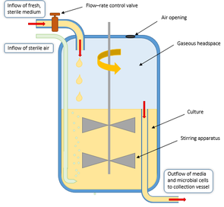
Continuous culture system for obtaining the Foreign Gene Product
In a continuous culture system, medium is drained out from one side while fresh medium is added from the other to maintain the cells in their physiologically most active log/exponential phase.
Continuous culture system produces a larger biomass leading to higher yields of desired protein.

Slide 60
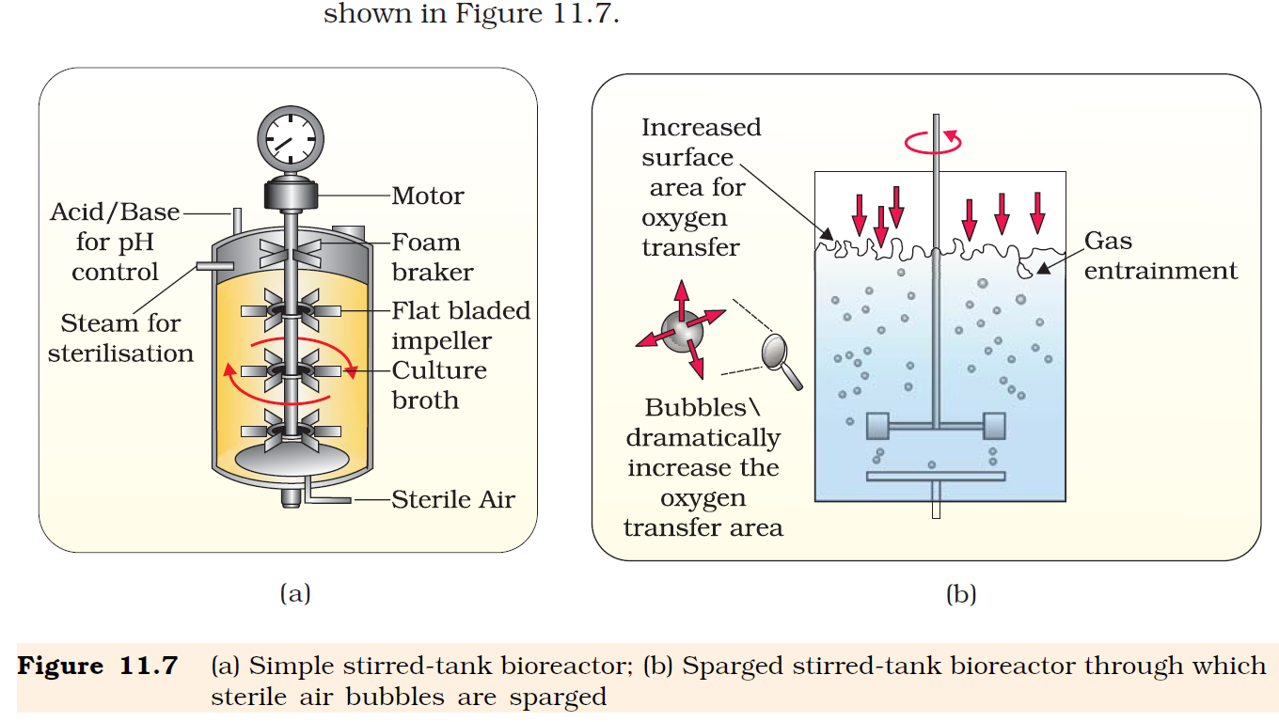
Bioreactors
Bioreactors are large vessels (with volumes of 100-1000 litres) in which raw materials are biologically converted into specific products (like enzymes, proteins, biochemicals, etc.,) in large quantities using microbial, plant, animal or human cells.
A bioreactor provides the optimal growth conditions (temperature, pH, substrate, salts, vitamins, oxygen) for achieving production of the desired product.
The most commonly used bioreactors are of stirring type.
Bioreactors
Stirred tank bioreactor

Slide 61
Stirred tank bioreactor for obtaining the foreign gene product
A stirred-tank reactor is usually cylindrical or with a curved base to facilitate the mixing of the reactor contents.
The stirrer facilitates
even mixing and oxygen availability throughout the bioreactor and
air supply through the bioreactor.
Stirred tank bioreactor has
an agitator system,
an oxygen delivery system
a foam control system,
a temperature control system,
pH control system and
sampling ports for drawing out small volumes of the culture periodically.

Slide 62
Sparged stirred tank bioreactor

Slide 63
Downstream Processing
After completion of the biosynthetic stage, the product has to be subjected through a series of processes before it is ready for marketing as a finished product.
The downstream processing include
separation of the recombinant protein
purification of the recombinant protein.
Formulation of the product(s) with suitable preservatives.
Clinical trials in case of drugs.
Quality control testing
The downstream processing and quality control testing vary from product to product.

Slide 64
Chapter ends here.....

Slide 65
Insertion of Recombinant DNA into the Host Cell/Organism
There are several methods of introducing the ligated DNA into recipient cells.
Recipient cells after making them ‘competent’ to receive, take up DNA present in its surrounding.
If a recombinant DNA bearing gene for resistance to an antibiotic (e.g., ampicillin) is transferred into E. coli cells, the host cells become transformed into ampicillin-resistant cells.
If we spread the transformed cells on agar plates containing ampicillin, only transformants will grow, untransformed recipient cells will die.
Due to ampicillin resistance gene, one is able to select a transformed cell in the presence of ampicillin.
The ampicillin resistance gene in this case is called a selectable marker.

Slide 66
Diagrammatic representation of recombinant DNA technology
rDNA

Slide 67
Obtaining the Foreign Gene Product
When rDNA is transferred into a bacterial, plant or animal cell, the gene of interest gets multiplied.
In almost all recominant technologies, the ultimate aim is to produce a desirable protein. Hence, there is a need for the recombinant DNA to be expressed.
The foreign gene gets expressed under appropriate conditions. The expression of foreign genes in host cells involve understanding many technical details.
After having cloned the gene of interest and having optimised the conditions to induce the expression of the target protein, one has to consider producing it on a large scale.
If any protein encoding gene is expressed in a heterologous host, is called a recombinant protein.
The cells harbouring cloned genes of interest may be grown on a small scale in the laboratory.
The cultures may be used for extracting the desired protein and then purifying it by using different separation techniques.

Slide 68
Obtaining the Foreign Gene Product
The cells can also be multiplied in a continuous culture system wherein the used medium is drained out from one side while fresh medium is added from the other to maintain the cells in their physiologically most active log/exponential phase.
Continuous culture system type of culturing method produces a larger biomass leading to higher yields of desired protein.
Small volume cultures cannot yield appreciable quantities of products.
Bioreactors with volumes of 100-1000 litres are required to produce products in large quantities.
Bioreactors are vessels in which raw materials are biologically converted into specific products like enzymes, proteins, biochemicals, etc., using microbial plant, animal or human cells.
A bioreactor provides the optimal growth conditions (temperature, pH, substrate, salts, vitamins, oxygen) for achieving the desired product.
The most commonly used bioreacters are of stirring type.

Slide 69
Stirred tank bioreactor for obtaining the foreign gene product
A stirred-tank reactor is usually cylindrical or with a curved base to facilitate the mixing of the reactor contents.
The stirrer facilitates
even mixing and oxygen availability throughout the bioreactor and
air supply through the reactor.
Stirred tank bioreactor has
an agitator system,
an oxygen delivery system
a foam control system,
a temperature control system,
pH control system and
sampling ports for drawing out small volumes of the culture periodically.

Slide 70
Sparged stirred tank bioreactor

Slide 71
Downstream Processing
After completion of the biosynthetic stage, the product has to be subjected through a series of processes before it is ready for marketing as a finished product.
The downstream processing include separation and purification.
The product has to be formulated with suitable preservatives.
In case of drugs, formulation with suitable preservative has to pass clinical trials.
Strict quality control testing for each product is also required.
The downstream processing and quality control testing vary from product to product.

Slide 72
Simple stirred-tank bioreactor
Agitator system
Oxygen delivery system
Foam control system
Temperature control system
pH control system
Sampling ports

Slide 73
Origin of replication (ori)
Specific sequence of DNA
Responsible for initiating replication.
For the multiplication of any alien piece of DNA in an organism it needs to be a part of ‘origin of replication’.
rDNA

Slide 74
Vectors for cloning genes in plants and animals
A better understanding of the art of delivering genes by pathogens in their eukaryotic hosts has generated knowledge to transform these tools of pathogens into useful vectors for delivering genes of interest to humans.
The tumor inducing (Ti) plasmid of Agrobacterium tumifaciens has now been modified into a cloning vector which is no more pathogenic to the plants but is still able to use the mechanisms to deliver genes of our interest into a variety of plants.
Similarly, retroviruses have also been disarmed and are now used to deliver desirable genes into animal cells. So, once a gene or a DNA fragment has been ligated into a suitable vector it is transferred into a bacterial, plant or animal host (where it multiplies).

Slide 75
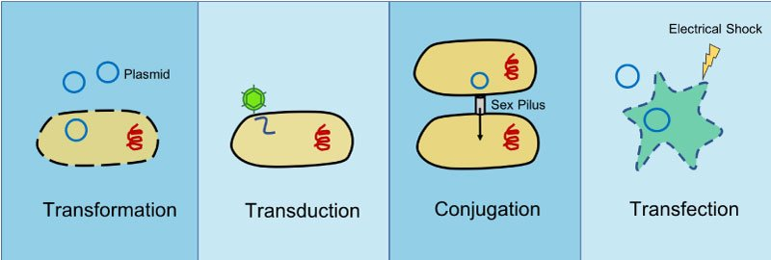

Slide 76
